Slide 1
Recovering Variable Names for Minified Code with Usage Contexts
ICSE 2019 - Montreal, Canada
Authors: Hieu Tran, Ngoc Tran, Son Nguyen, Hoan Nguyen, Tien N Nguyen

Slide 2

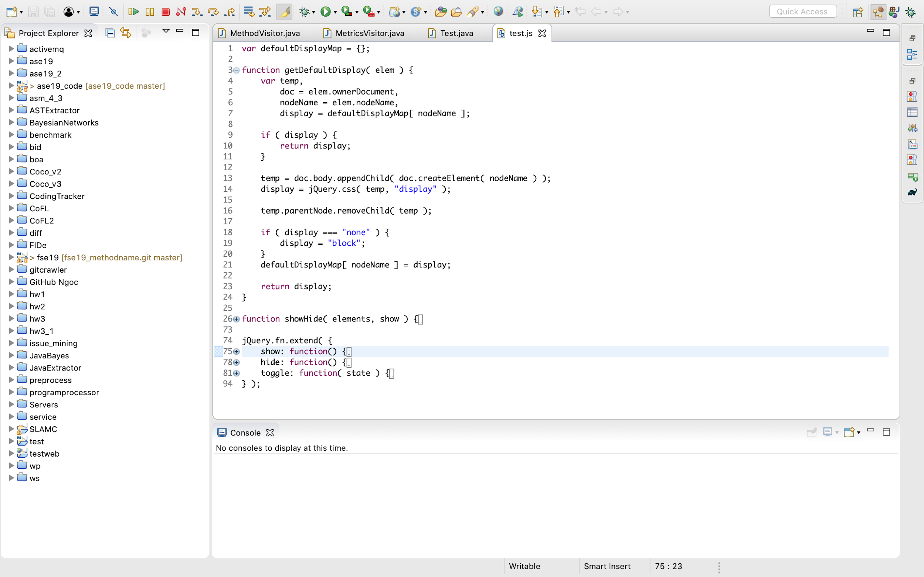




Variable Names in Web Development
Notes:
Meaningful names in original code
Minified for optimization purpose

Slide 3

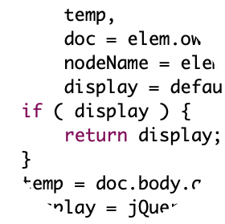

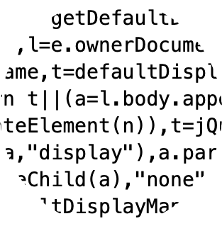
Variable Names in Web Development
script.js
Notes:
Meaningful names in original code
Minified for optimization purpose

Slide 4
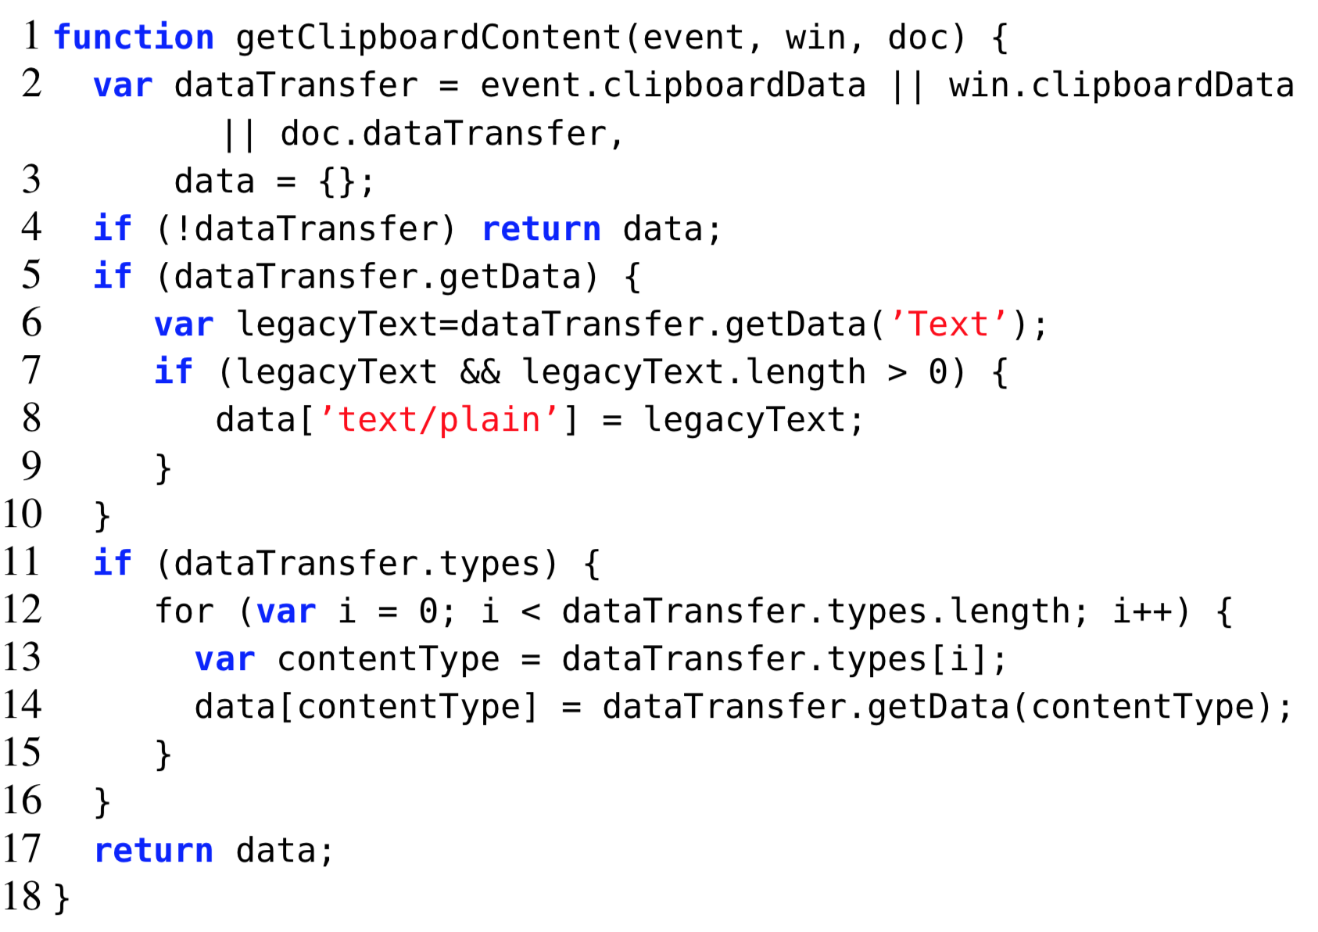
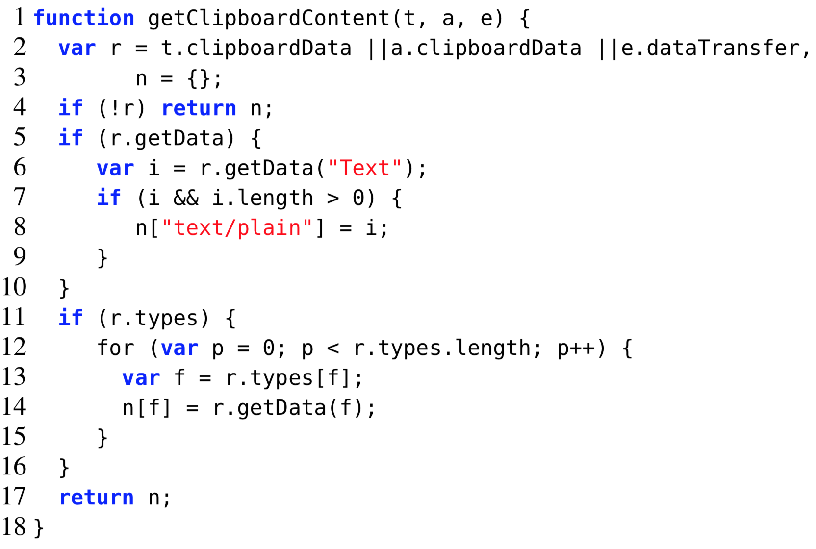
Example
Minify

Slide 5

Example
Minify

Slide 6
Recovering Variable Names for Minified Code
Recover

Slide 7

Recovering Variable Names for Minified Code

Slide 8

Recovering Variable Names for Minified Code

Slide 9

JSNice [Raychev et al. POPL ’15]
Learned Model
Input
minified JS
Dependency
Graph
Predicted
Variable name
Output JS

Slide 10

JSNaughty [Vasilescu et al. FSE’17]
Input
minified JS
SMT
Output JS

Slide 11
JSNice and JSNaughty
Require large training data
Use computationally expensive ML algorithms
Scalability issue
Low accuracy

Slide 12
Meaningful names of minified variables
could be observed in a large corpus
1
Notes:
IR-based, data-driven approach to recover the variables’ names in a minified JS code based on the contextual information
Meaningful names of minified variables could be observed in a large corpus

Slide 13
The name chosen should be natural in the context and follow naming conventions
2
Notes:
IR-based, data-driven approach to recover the variables’ names in a minified JS code based on the contextual information
Meaningful names of minified variables could be observed in a large corpus

Slide 14

Single-variable usage context
r
Notes:
Its own properties and roles in the source code

Slide 15



Single-variable usage context
31
7
1
dataTransfer
dataTransfer
Notes:
Its own properties and roles in the source code

Slide 16

Multiple-variable usage context
Venus
????
Mars
????
Solar “family”
Notes:
The names of variables co-occurring in the same function

Slide 17
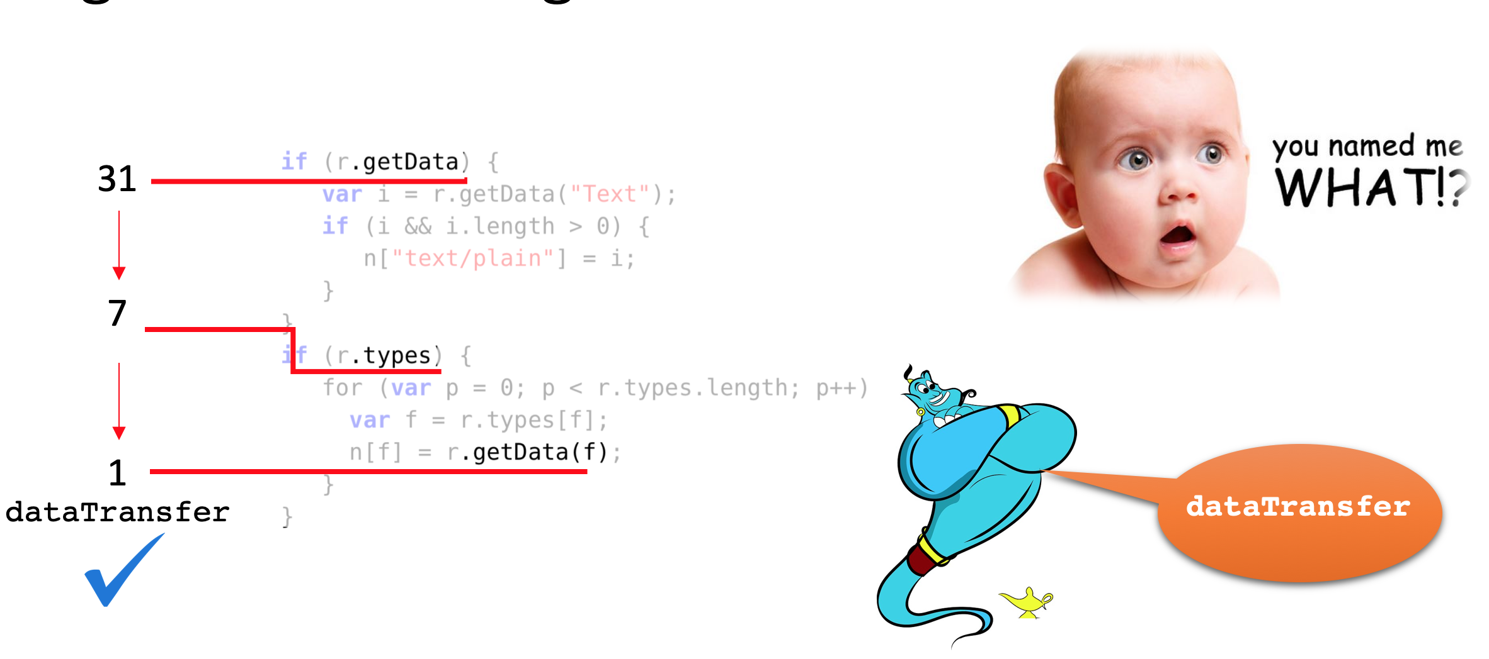
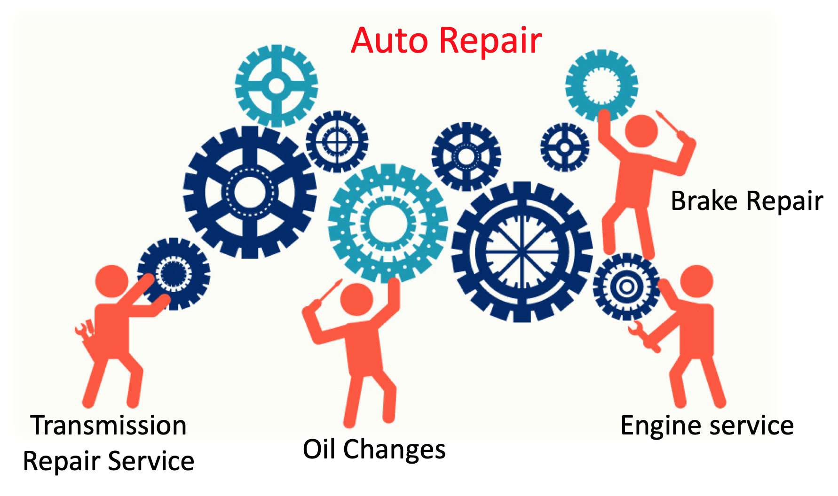
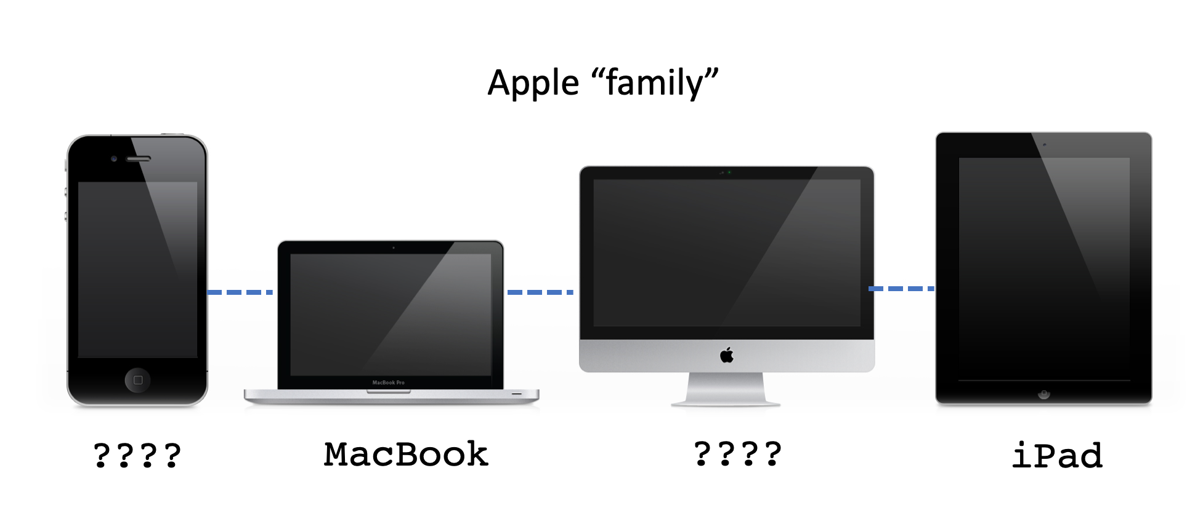

Slide 18

Multiple-variable usage context
Apple “family”
????
MacBook
????
iPad
Notes:
The names of variables co-occurring in the same function

Slide 19
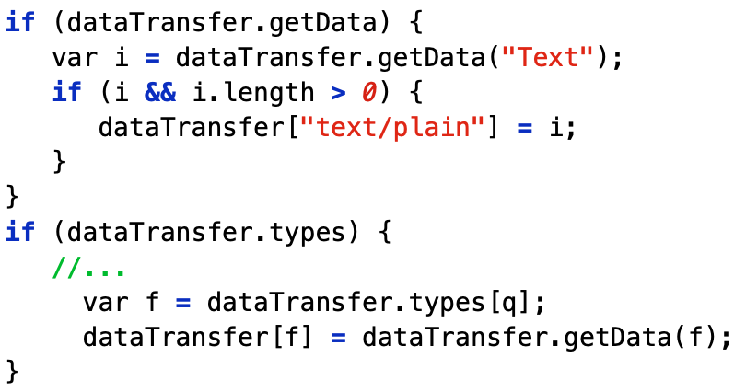
Multiple-variable usage context
Notes:
The names of variables co-occurring in the same function

Slide 20

Multiple-variable usage context
Single-variable usage context
4
In the same function
7
1
legacyText
contentType
Notes:
The names of variables co-occurring in the same function

Slide 21


Task-specific context
Auto Repair
Brake Repair
Transmission
Repair Service
Engine service
Oil Changes
Notes:
The current task of the function to which the variable belongs and contributes

Slide 22
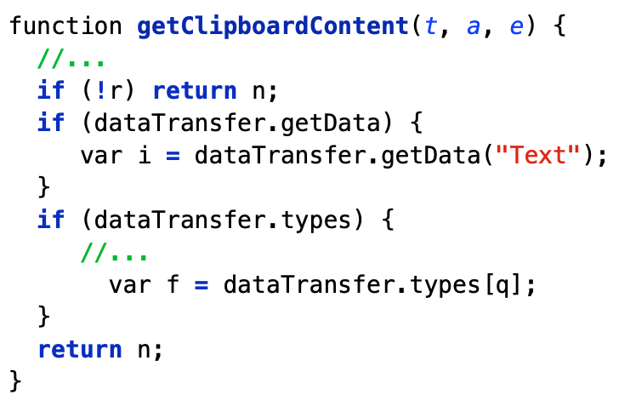
Task-specific context
data
dataTransfer
contentType
event
...
Get the clipboard’s content
Relevant
variable names
Notes:
The current task of the function to which the variable belongs and contributes

Slide 23

JSNeat
An IR-based approach to recover the variable names based on
the contextual information

Slide 24
Single-variable usage context (SVC)
Present the roles and the properties of a variable using Relation Graph
Derive candidate names by matching SVC
dataTransfer
getData
assign
fieldAcc
r
dataTransfer
fieldAcc
call
call
fieldAcc
types
getData()
types
getData()

Slide 25
Single-variable usage context (SVC)
open
dataTransfer
getData
call
assign
fieldAcc
r
win
dataTransfer
fieldAcc
fieldAcc
call
call
fieldAcc
types
getData()
types
getData()
clipboardData
Matching

Slide 26
Single-variable usage context (SVC)
Not Matched
open
dataTransfer
getData
call
assign
fieldAcc
r
win
dataTransfer
fieldAcc
fieldAcc
call
call
fieldAcc
types
getData()
types
getData()
clipboardData
Matching

Slide 27
Single-variable usage context (SVC)
Not Matched
open
dataTransfer
getData
call
assign
fieldAcc
r
win
dataTransfer
fieldAcc
fieldAcc
call
call
fieldAcc
types
getData()
types
getData()
clipboardData
Matching

Slide 28
Single-variable usage context (SVC)
dataTransfer is considered as a candidate name for variable r
Not Matched
open
dataTransfer
Matched
getData
call
assign
fieldAcc
r
win
dataTransfer
fieldAcc
fieldAcc
call
call
fieldAcc
types
getData()
types
getData()
clipboardData
Matching

Slide 29

Multiple-variable usage context (MVC)
The names of variables are naturally consistent with one another wrt the common task
The candidate names of multiple variables are ranked based on their co-occurrence
iPhone, iMac & iPad always go together
bananaPhone
iPhone
Mark Z
Apple III
iMac
???
MacBook
???
iPad

Slide 30
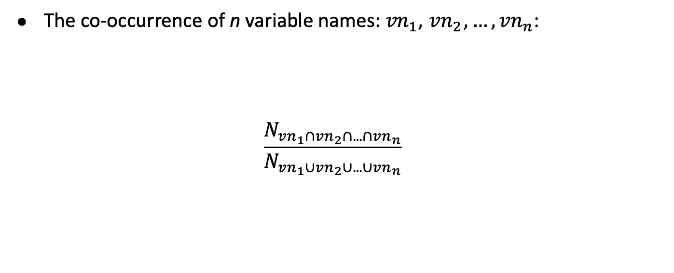
Multiple-variable usage context (MVC)
#Functions that contain all the names
#Functions that contain at least one of the names

Slide 31
Multiple-variable usage context
text
legacyText
txt
…
legacyText
contentType
The most likely
pair of names
elementType
dataType
contentType
…
Notes:
The names of variables co-occurring in the same function

Slide 32
Multiple-variable usage context (MVC)
Backup for beam search
Notes:
Backup for beamsearch

Slide 33
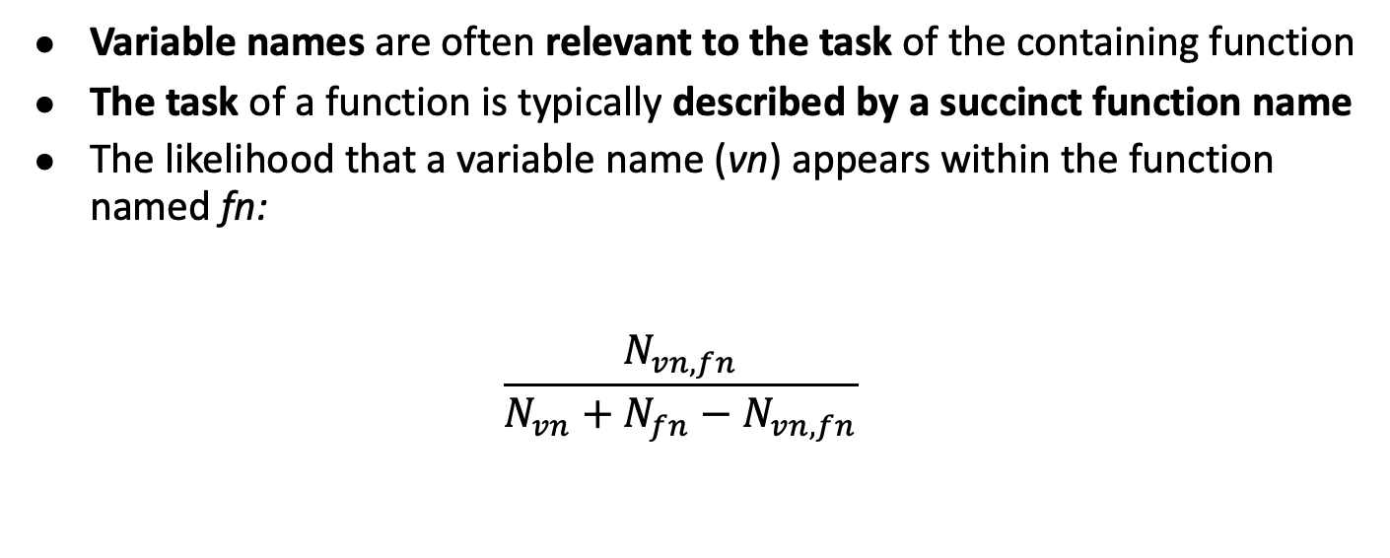
Task-specific context (TSC)
#Functions where vn is used
#Functions where vn and fn go together
#Functions where fn is used

Slide 34

JSNeat
Original JS
Extracting Contextual Info
Database
Minified JS
Extracting Contextual Info
SVC and TSC Matching
MVC Ranking

Slide 35



Empirical Evaluation
1
Comparative Study
2
Context Analysis
3
Sensitivity Analysis
4
Time Complexity

Slide 36
Data Collection
12K open-source JS projects
 | Test Corpus | Training Corpus | Total
Files | 2K | 320K | 322K
Functions | 6K | 961K | 967K
Variables | 19K | 348K | 3.5K
Notes:
followed the same procedure in previous work to collect and clean up data

Slide 37
Procedure and Metrics
Exact-matched Accuracy

Slide 38
Accuracy Comparison
Relative improvements of 66.1% and 43%
over JSNice and JSNaughty, respectively

Slide 39
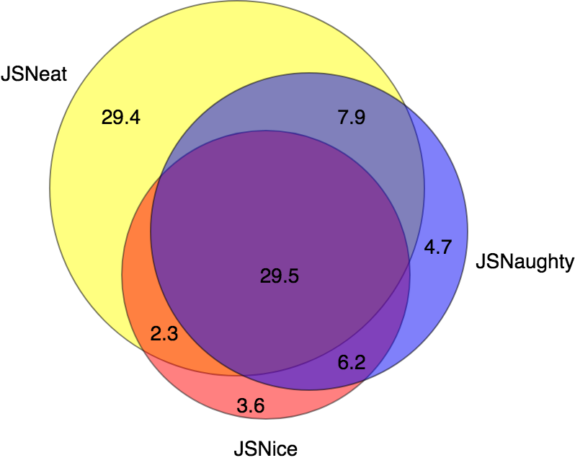
Accuracy Comparison
While SVC does not have enough information,
TSC provides useful information to help in those cases
When MVC is disabled, decreases by 7.4%
When TSC is disabled, decreases by 21.8%

Slide 40
Accuracy Comparison
SVC contributes most to that 29.4% of these cases
When MVC is disabled, decreases by 7.4%
When TSC is disabled, decreases by 21.8%
When SVC is disabled, decreases by 29.2%

Slide 41
Context Analysis
Combination of Contexts | Accuracy (%) | Time (ms)
Task (TSC) | 5.2 | 1.3
SingleVar (SVC) | 33.7 | 1.5
Task + SingleVar | 47.3 | 2.1
Task + MultiVar (MVC) | 9.3 | 2.3
SingleVar + MultiVar | 37.8 | 2.6
Task + SingleVar + MultiVar (= JSNEAT) | 63.1 | 3.2

Slide 42
10-fold Cross-Validation
The accuracies for all the folds are stable
Test Fold | 1 | 2 | 3 | 4 | 5 | 6 | 7 | 8 | 9 | 10
 | 63.1 | 63.0 | 63.9 | 63.3 | 62.7 | 63.8 | 63.4 | 62.9 | 63.1 | 62.5’

Slide 43
Sensitivity Analysis
The accuracy in increase linearly and consistently
with the training size
Impact of Training Data’s Size on Accuracy
#Folds | 1 | 2 | 3 | 4 | 5 | 6 | 7 | 8 | 9
ACC(%) | 40.1 | 47.3 | 52.5 | 54.9 | 56.4 | 58.2 | 60.0 | 62.2 | 63.1
Notes:
For others, pls read the paper

Slide 44
Time Complexity
JSNeat’s recovering time of is 2x and 4x faster than JSNice and Jnaughty
JSNeat’s traing time of is 4x and 6x as fast as with JSNice and JNaughty
 | JSNeat | JSNice | JSNaughty
Training | 2h05m | 3h35m | 12h25m
Recovering | 2.9ms | 6.6ms | 11.8ms

Slide 45
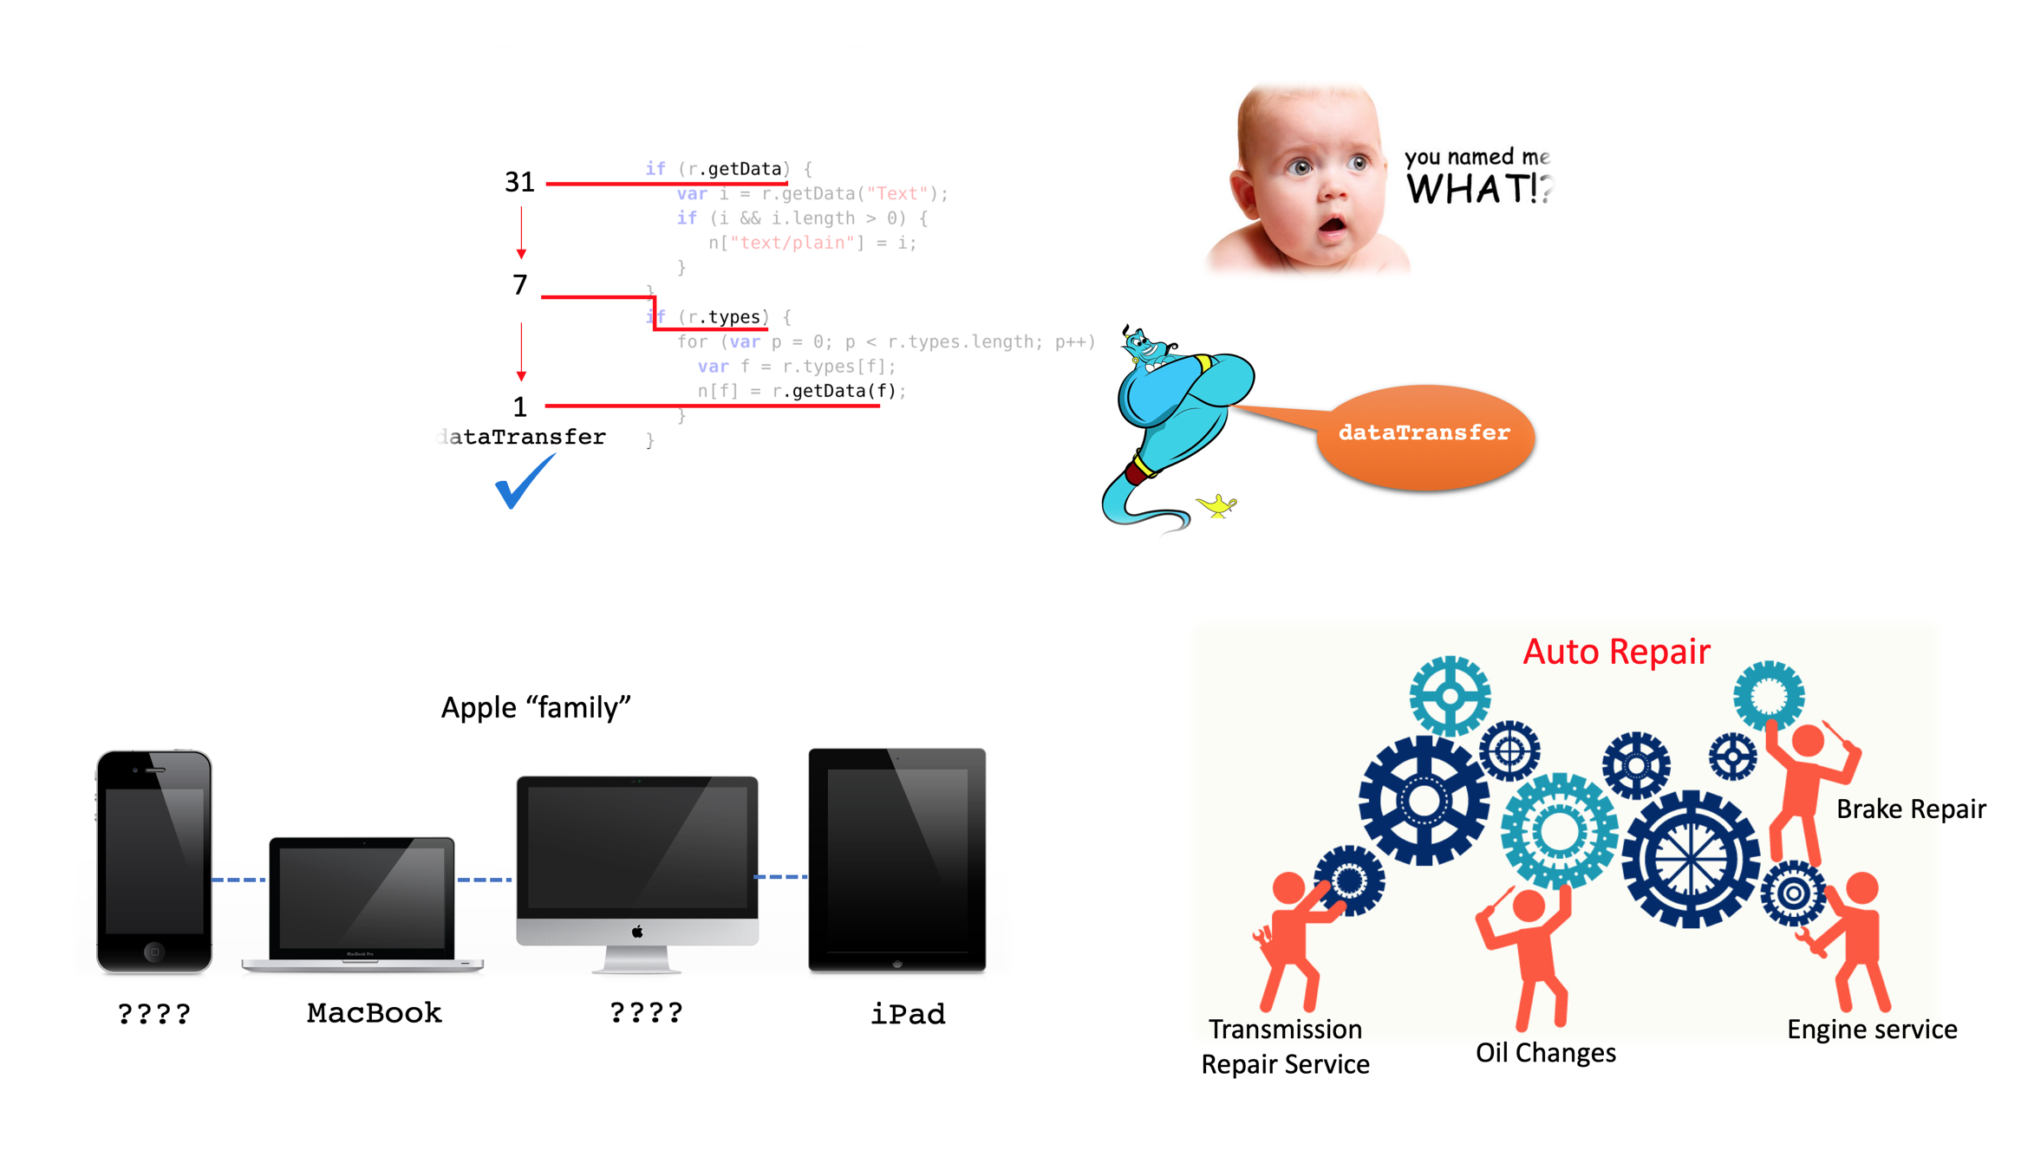
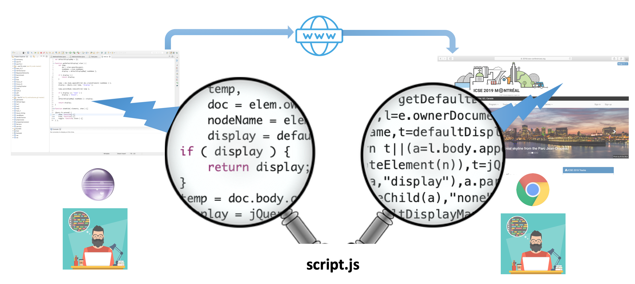
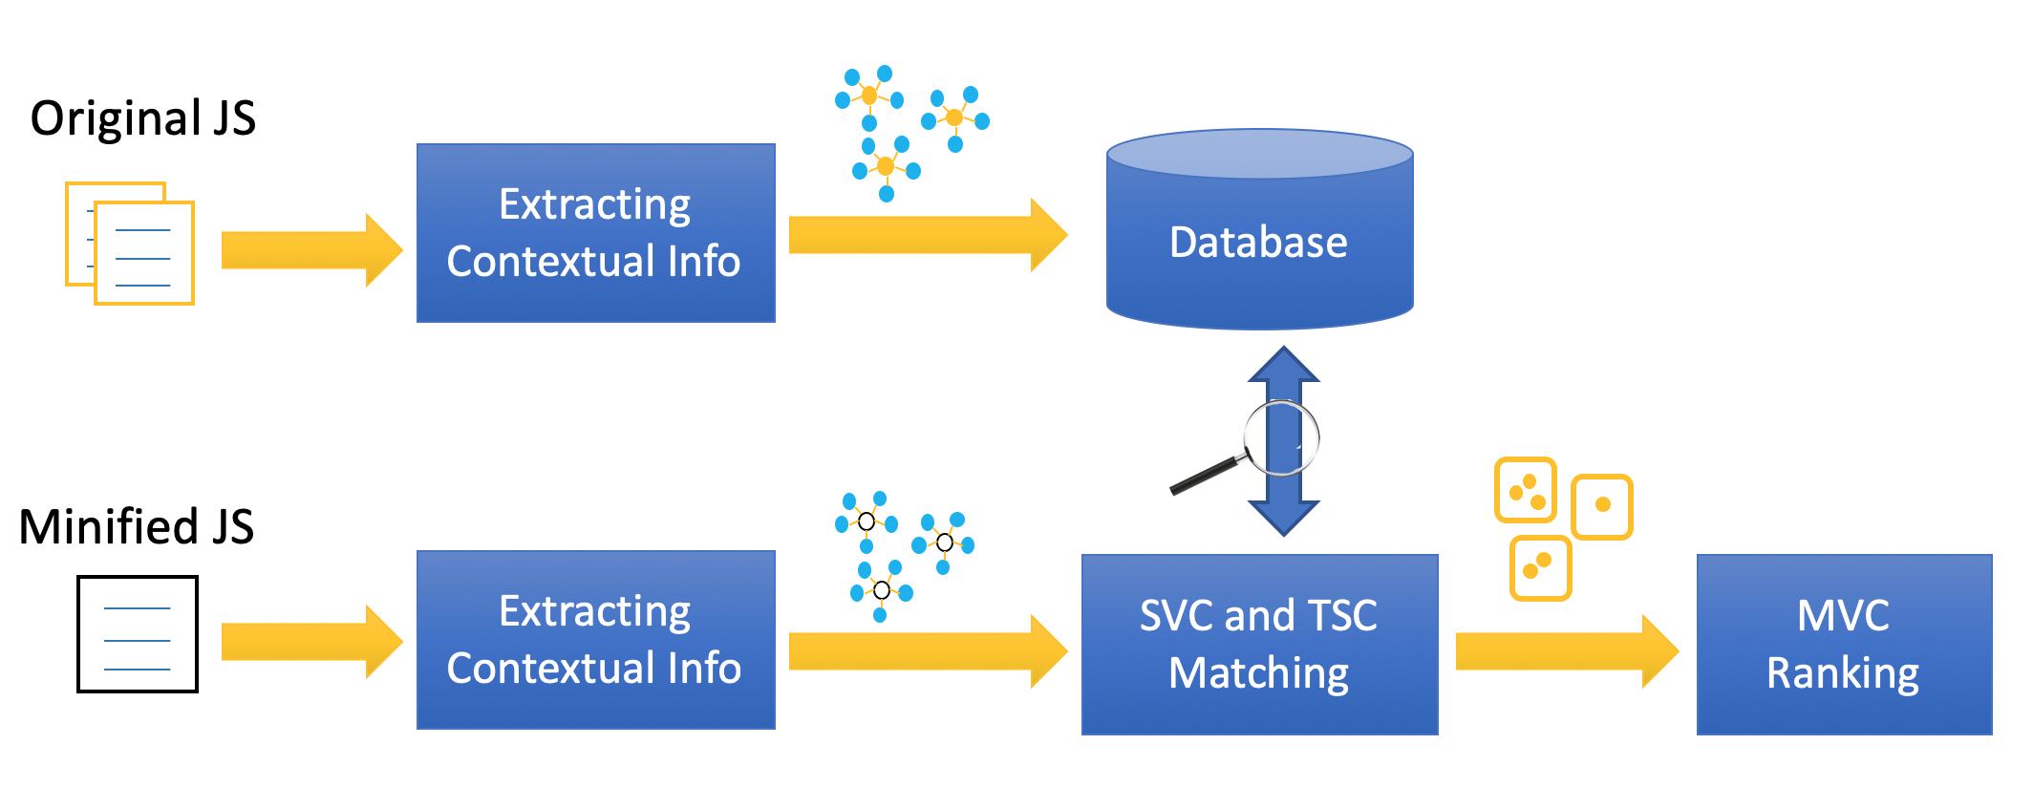
JSNeat

Slide 46
Thank for your attention!

